Slide 1

Web Application Development
React
Setting up an API, Fetching Data with Axios, Display API data, CRUD operations
By Ebad Majeed

Slide 2
Backend?
Create a backend first, refer to lecture notes on blackboard
(same as week 04)

Slide 3
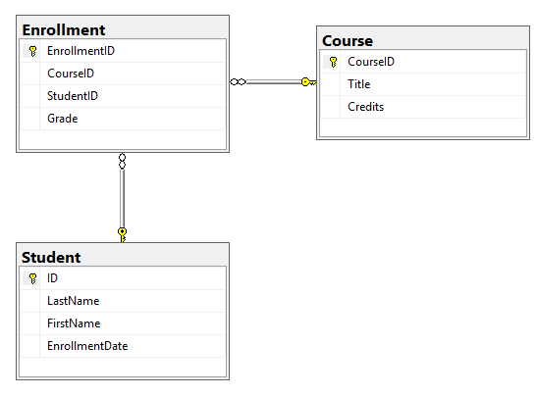
Breaking the many to many relationship

Slide 4
Create react app
Create-react-app interface
Npm install axios
Get the components, apiConfig and app from blackboard
Understanding the react code

Slide 5
Configure CORS in your Startup.cs file:
In your Startup.cs file, add the following code to enable CORS:
builder.Services.AddCors(options =>
{
options.AddPolicy("AllowReactApp",
builder =>
{
builder.WithOrigins("http://localhost:3000")
.AllowAnyHeader()
.AllowAnyMethod();
});
});

Slide 6
Configure CORS in your Startup.cs file:
In the program.cs file, make sure to use UseCors before app.Run():
app.UseCors("AllowReactApp");

